Slide 1
DASH
Advanced Visualization Topic Presentation
11/29/2021
By: George Smith

Slide 2
WHAT IS DASH ?
Dash is an open source Python library for creating reactive, Web-based applications
DASH EXPLAINED
Dash began as a public POC on Github in 2015
Dash is a user interface library for creating analytical web applications
The target users are those who use Python for data analysis, data exploration, visualization, modelling, instrument control, and reporting
Dash makes it easy to build a GUI (Graphical User Interface) around your data analysis code

Slide 3
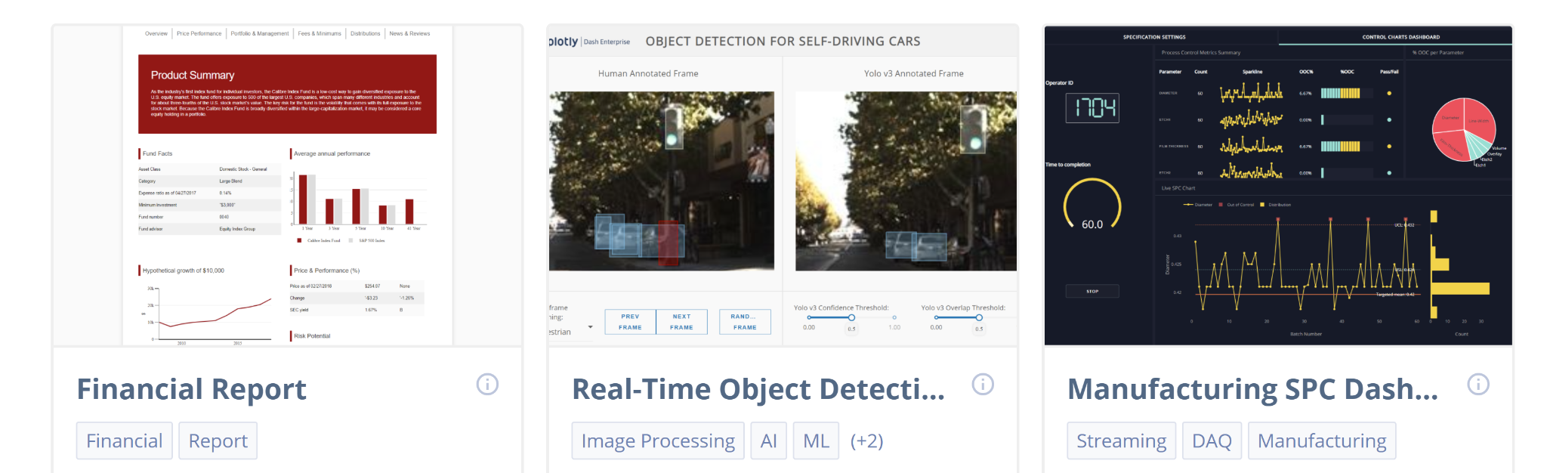
WHAT CAN DASH CREATE ?
Dash is a library framework all in python that allows you to create interactive web application dashboards
APPLICATIONS
The Dash Enterprise App Gallery includes 110 applications that can be used to design dashboards for:
Financial Reporting
Real-time object Detection
Manufacturing
Windspeed
World Cell Towers
Image Processing
Support Vector Machine
ETC.

Slide 4
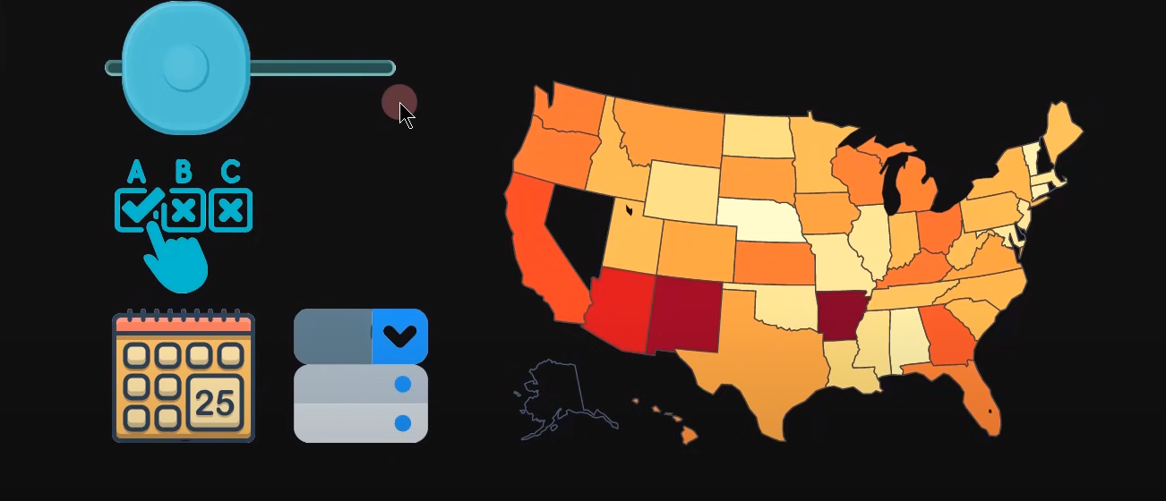
THREE PILLARS OF DASH
The first Dash pillar includes the Dash components
DASH COMPONENTS
Dash components consist of anything from the slider, the check box, the date picker, etc.
Anything that creates an interactive capability inside your data is considered a component
All components can be found at https://dash.plotly.com/dash-core-components

Slide 5
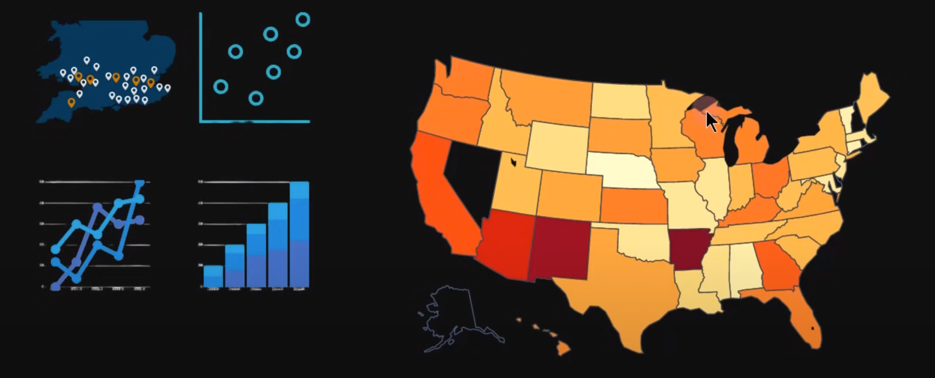
THREE PILLARS OF DASH
The Second Dash pillar includes Plotly Graphs
PLOTLY GRAPHS
Plotly Graphs consists of the graphs charts and other type of data visualization plots,
They arrange anywhere from mapbox, scatter plot, line chart, bar chart, etc.
All plotly data visualizations can be found at https://plotly.com/python/

Slide 6
THREE PILLARS OF DASH
The Third Dash pillar includes the Callback
THE CALLBACK
The Callback connects the dash components to the plotly graphs to create an interactive capability
Additional information on the callback can be found https://dash.plotly.com/basic-callbacks
Understanding how the pillars relate to one another and mastering connecting each of the pillars will allow you to create advanced interactive visualizations

Slide 7
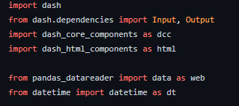
USING DASH
In order to use dash it is necessary to import the proper libraries
DASH LIBRARIES
Dash Libraries
Other

Slide 8
USING DASH
DROPDOWN EXAMPLE

Slide 9
xxx
xxx
xxx
xxx

Slide 10
xxx
xxx
xxx
xxx

